Slide 1
What makes employees leave: A tale of two organisations
By Brianna O’Connor and Shannon Chen
Notes:
“Hi, we are group 2 comprising of Brianna and myself. Our project is titled: What makes employees leave – A tale of two organisations.”
General flow:
1. Intro (Shannon)
2. Findings
Salary & Tenure trends (by Department/Age/Gender etc) (split between Brianna & Shannon)
Performance Management/Promotions (split between Brianna & Shannon)
Designation trends (Brianna)
Workload (Shannon)
3. Conclusion: Recommendations and Limitations (Brianna)

Slide 2



Why did we choose to investigate this topic?
What data did we want? Did we find it?
How did we settle on a suitable dataset?
Notes:
[Shannon]
1. Why choose this topic - We chose this topic because we wanted to apply what we had learnt thus far to the field of Human Resource Management. We were initially keen to examine how pre-employment assessments can pick up factors that influence workplace accidents rates.
2. To get the data - We first looked at governing bodies such as SafeWork and other public sources such as ABS. However, most of the datasets from these sources were aggregated and seem to be closer in nature to the ‘big picture’ end products that we wanted to generate through own analyses..
3. Given that we couldn’t do much with the publicly available datasets on workplace accidents, we shifted our focus to look at employee attrition. Kaggle had an abundance of granular datasets on this topic that we could use.
Image sources:
HR Analytics (https://greatpeopleinside.com/analytics-in-hr/)
Worksite people planning (https://employsure.com.au/blog/ohs-changes-in-victoria/)
Pre-employment medical check (https://www.inselec.com.au/electrical-worker-pre-employment-medical-template/)

Slide 3




Preparing the Data
Org A: Sales Team in an Insurance Firm
Over 19k rows of data
employee data noted at multiple timepoints
2381 Unique Employees
Org B: Organisation from an unspecified industry
Over 14k Unique Employees
Multiple departments
Notes:
[Shannon]
For a richer analysis, we looked at data from 2 separate organisations. Both datasets had similar variables relating to remuneration, time with the company, hours worked and satisfaction - although some were represented differently (e.g., categorical salary variable vs numerical salary variable). We wanted to see whether trends associated with turnover were similar for both organisations (e.g., did employees in both organisations leave because their salary did not match their work contributions).
To enable the comparison, both datasets required further cleaning.
[Will share only 2] Without going into too much detail, we:
1. Created a variables to capture whether an employee had stayed or left from their joining date and last date.
2. Removed duplicates due to data being collected over multiple time points.
3. Amended how categorical variables were labelled to ensure they aligned across both datasets.
4. Aligned unit of measurement for tenure (from years to days).

Slide 4


Who are leaving?
The Best and the Brightest? ‘Bad’ workers? Certain Departments?
Why did they leave?
Working across the lifespan? Demographic trends?
Performance Management? Were employees’ salary proportional to their efforts and role? Were promotions given to the best worker?
Workload? Type of Work? Overworked employees? Long hours?
Notes:
[Shannon]
After preparing the data, we proceeded to answer the following questions with our exploratory data analyses:
Who are leaving?
Are the organisations losing their best and brightest?
Why did they leave?
Was it salary, workload or other factors that led to employee turnover?
Over the next few slides, our team will be sharing what we found from our analysis and propose some recommendations for organisations seeking to manage employee attrition. We will then conclude with a brief overview of our study’s limitations.
[Hand control of slides over to Brianna]

Slide 5
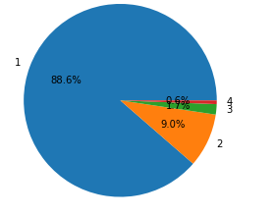
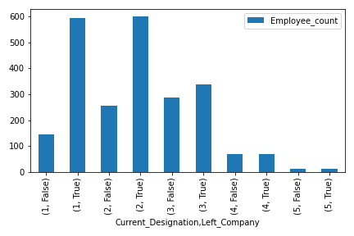
Who is leaving? Org A
In Org B
99.47% of employees who left:
NO promotion in the last 5 years
Despite having best evaluation, working more hours and taking on more projects on average
Poor performers & lower designations
88% of employees leaving had a quarterly rating of 1
Lower designations are over-represented in the leaving statistics
Notes:
TBC
Feel free to change the layout as this is just a placeholder

Slide 6
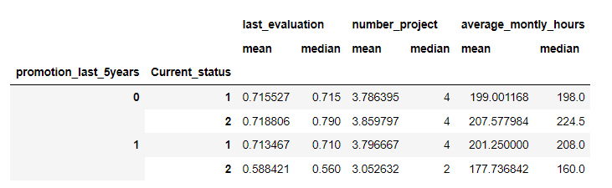
Who are leaving? Org B
99.47% of employees who left:
NO promotion in the last 5 years
Despite having best recent evaluation, working more hours, and taking on more projects as compared to other employees
Notes:
Whereas for ORG B: Total of 3571 Employees left. Ran a .loc to locate how many did not receive a promotion in the last 5 years and subsequently left the organisation.
This step revealed such 3552 employees - who did not receive a promotion in the last 5 years despite their most recent revaluation, average working hours per month, and number of projects allocated being the highest compared to other subsets of employees. This suggests that the best performers and hardest workers in Org B are turning over.

Slide 7
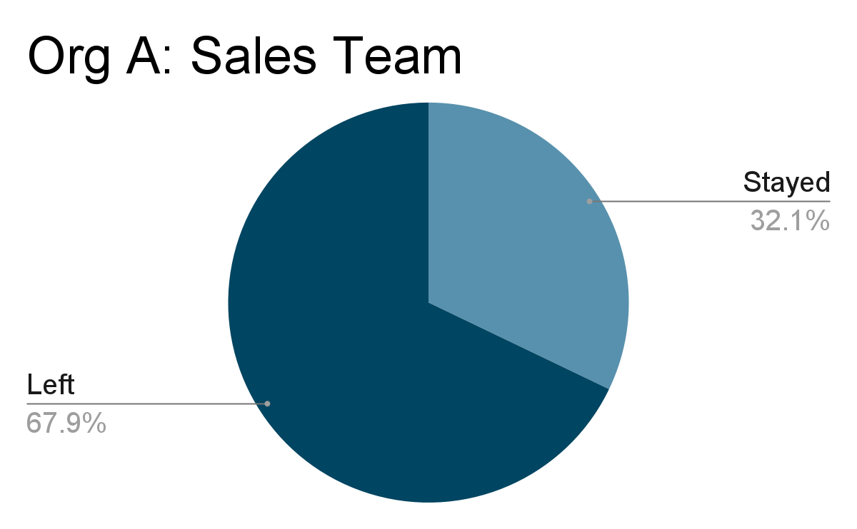
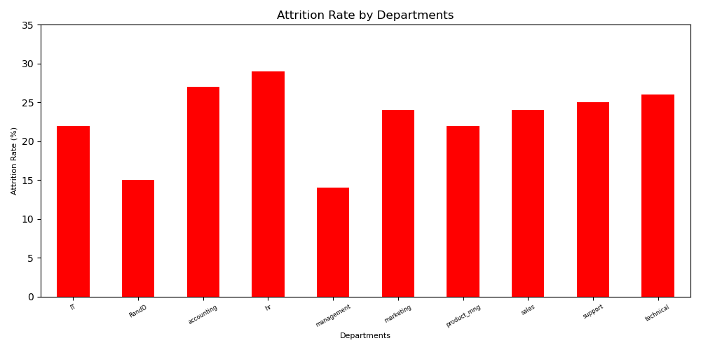
Who are leaving? Attrition Rate By Department
67.9% for Sales
Org B: HR, Accounting and Technical have highest rates (all above 25%).
Sales Team (24%)
Notes:
Overall attrition rate for Org B: 3571/11428 = 31.3%
Next, we have a breakdown of attrition rate by department for both organisations. We only had data for Org A’s sales team but their attrition rate was almost triple that of Org B’s sales team.

Slide 8
Were employees’ salary proportional to their efforts and role?
Were promotions given to the best worker?
Performance Management

Slide 9
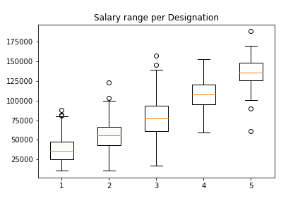
Performance Management: Salary
Salary per designation has huge range, with some level 1 employees being paid more than level 4 and 5 employees.

Slide 10
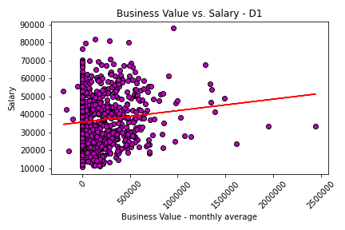
What determines Salary? Business Value?
Using Designation 1 as an example, we can see there are a multitude of employees with an average monthly business value of 0, regardless of their salary.
The top performers are not earning high salaries.

Slide 11
What determines Salary? Business Value?
There is very little correlation between salary and business value at designations 1 to 4, and no correlation at designation 5.
Designation | pvalue | rvalue | Coefficient of determination
D1 | 0.001430 | 0.116150 | 0.013491
D2 | 0.000000 | 0.223202 | 0.049819
D3 | 0.000000 | 0.211118 | 0.044571
D4 | 0.031103 | 0.181651 | 0.032997
D5 | 0.933843 | 0.017899 | 0.000320

Slide 12
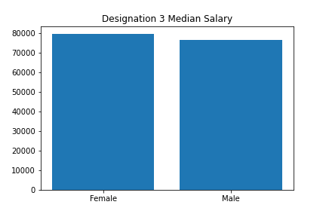
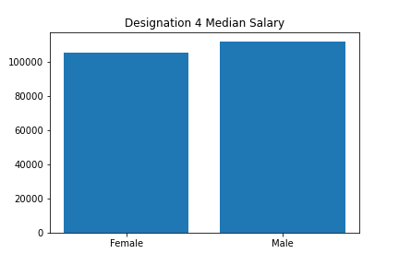
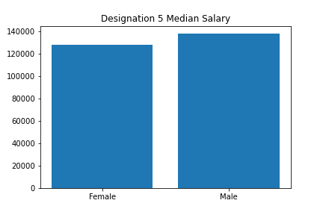
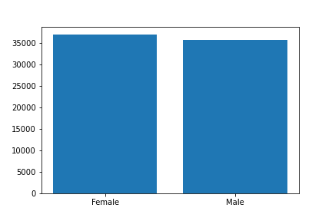
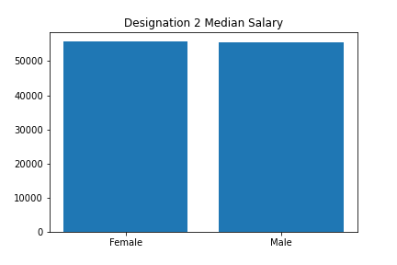
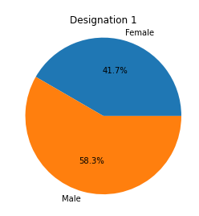




Gender bias? Unlikely . . .
58-60% male, 40-42% female at all levels.
Not 50-50 split expected
Proportion is same at all designations - women are not being held back from promotion
Salary is equal between genders at all levels - women are not being paid less for doing the same job

Slide 13
Did employees leave because they were overworked?
Workload & Type of Work
Notes:
Finally, we looked at whether workload had an impact on whether employees left.

Slide 14
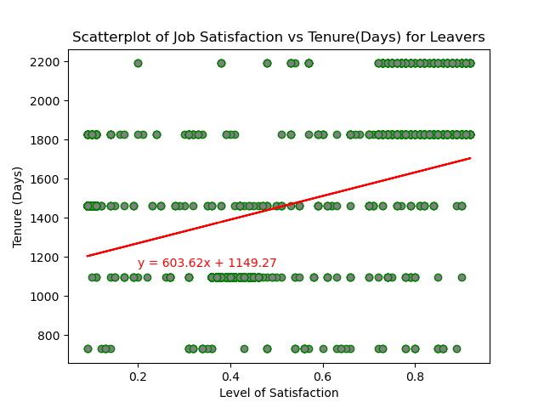
Why did they leave? (Job Satisfaction)
Org B - Job Satisfaction had an effect on tenure.
Employees who left Org B: Weak but significant positive correlation between Tenure(Days) and Job Satisfaction - 0.45 (p < .0001). As job satisfaction increases, tenure increases (and vice versa).
Org A - no Job Satisfaction variable
Notes:
In the dataset for Organisation B, we found that there was a weak but significant positive correlation between the tenure of employees who left and the level of satisfaction they had with their jobs. This suggests that being satisfied with their jobs were important for those who left – given that as job satisfaction increases, tenure increases.
Unfortunately, there was no variable that related to Job Satisfaction in the dataset for Organisation A. Thus, a comparison was not possible.

Slide 15
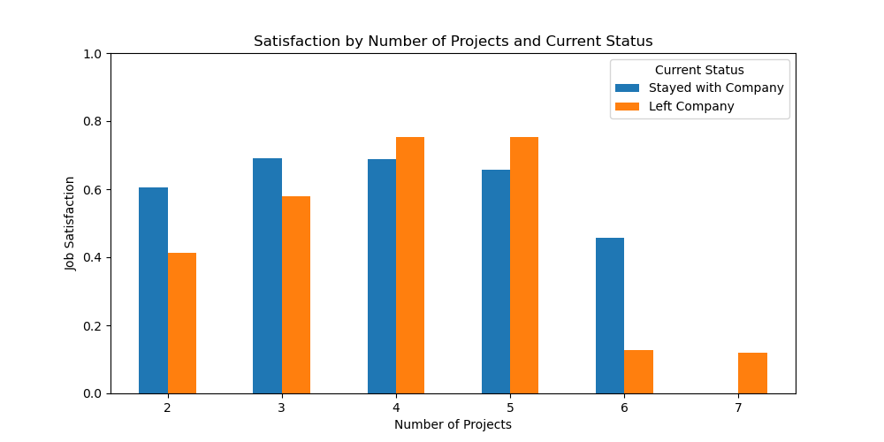
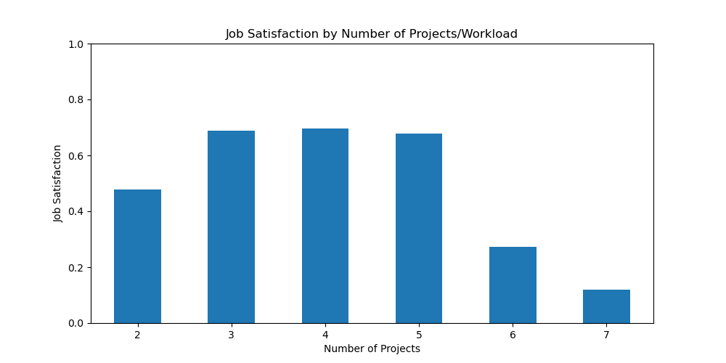
Why did they leave? (Workload)
For Org B: ‘Number of Projects’ operationalised as an employee’s workload, where more projects meant a higher workload.
Job Satisfaction is lowest when workload is high (Number of Projects > 5) or when workload is low (Number of Projects = 2). Trend persists when looking separately at stayers and leavers.
Notes:
How often have we heard that an excessively heavy workload leads to employees leaving. The data from Organisation B supports this notion as it shows that job satisfaction decreases dramatically when an employee is allocated more than 5 projects.
Interestingly, job satisfaction was also somewhat lower for employees who had only 2 projects. This suggests that being ‘underworked’ also adversely affects satisfaction. These trends persist when looking separately at current and former employees from Organisation B.

Slide 16
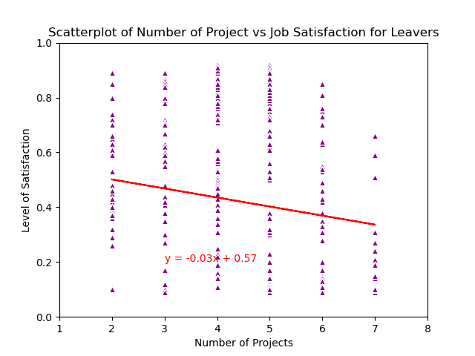
Relationship between workload and job satisfaction for leavers
Correlation between ‘Number of Projects’ (re. Workload) and Job Satisfaction: -0.23 (p < .0001)
Such that job satisfaction decreases as workload increases.
Notes:
Further analyses revealed a very weak but highly significant negative correlation (-0.23, p < .0001) correlation between ‘Number of Projects’ and Job Satisfaction amongst the employees who left Org B.
This suggests that job satisfaction decreases as workload increases for people who chose to leave Org B. Given the previously observed positive relationship between job satisfaction and tenure, increases in workload can potentially cut short an employee’s stay at a company.
I will now hand the stage over to Brianna who will share a few recommendations for tackling employee attrition and conclude with an overview of our study’s limitations.

Slide 17
Recommendations
[Rec…]
A tale as old as time - ensure that your best performers and hardest workers are recognised and rewarded. If not, they will leave.
Review salaries regularly to ensure fair reward. Consider bonuses or commissions for high earners
Low and high workload can potentially affect job satisfaction negatively.
Notes:
Add in other recommendations/conclusions once all slides are drafted.

Slide 18
Limitations of analysis
POINT 1 - both Companies Circumstances of Termination - did they quit or were they fired?
POINT 2 - both Companies Type of hire - recruitment agency, internship
POINT 3 - Org A Data from previous years to map career progression
POINT 4 - Org B Demographic information
POINT 5 - Org B Salary details
POINT 6 - Org B Data from previous dates - particularly evaluation and satisfaction
POINT 7 - Overall Findings Findings and recommendations may not be suited for all organisations as specific industries need to be considered.
Notes:
TBC
Feel free to change the layout as this is just a placeholder

